Slide 1
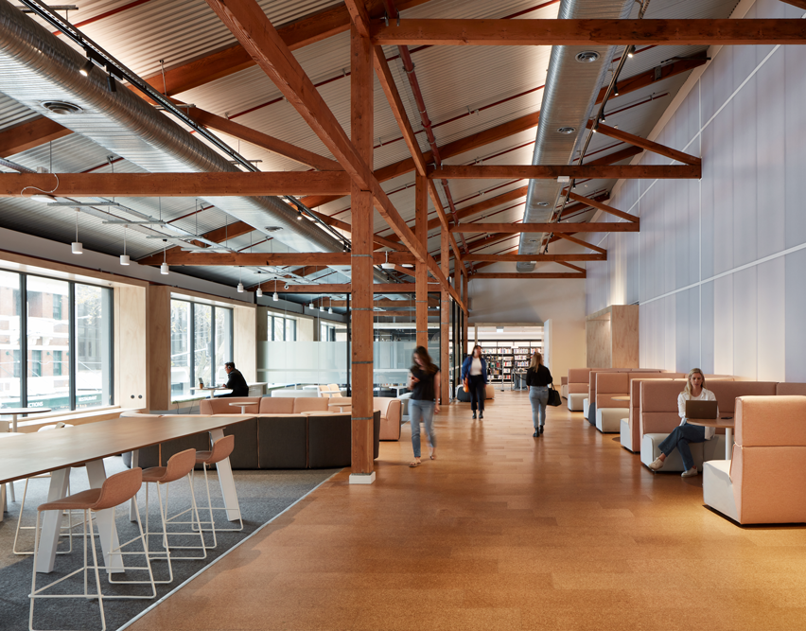

RESEARCH PRESENTATION: EVOLUTION OF TECHNOLOGY
Artificial Intelligence
RECOMMENDATION SYSTEMS
Moral and Ethical Impact​
& Immediate Effects on
Human Knowledge
October, 2025
Luis G. B. A. Faria
Student ID A00187785
Human-Centred Design
Prof Dr. Omid Haas

Slide 2
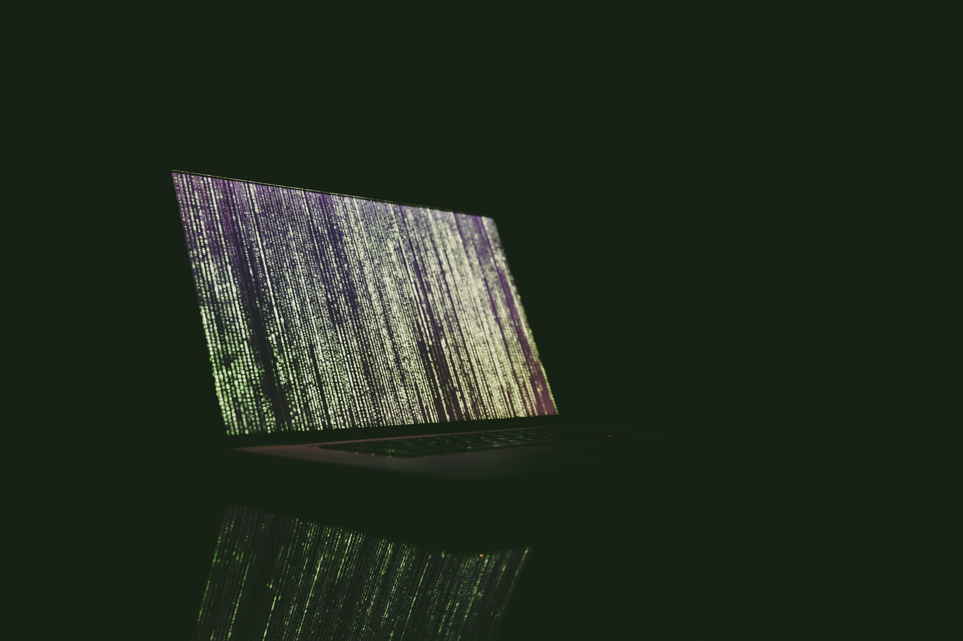



context
What are AI Recommender Systems?
Machine Learning Algorithms → Personalize content feeds
Use user data (watch time, themes, likes, comments) → optimize predictions
Accessibility: simplifies discovery, removes need to search
User
Algorithm
Personalized feed
+ infinite scroll

Slide 3
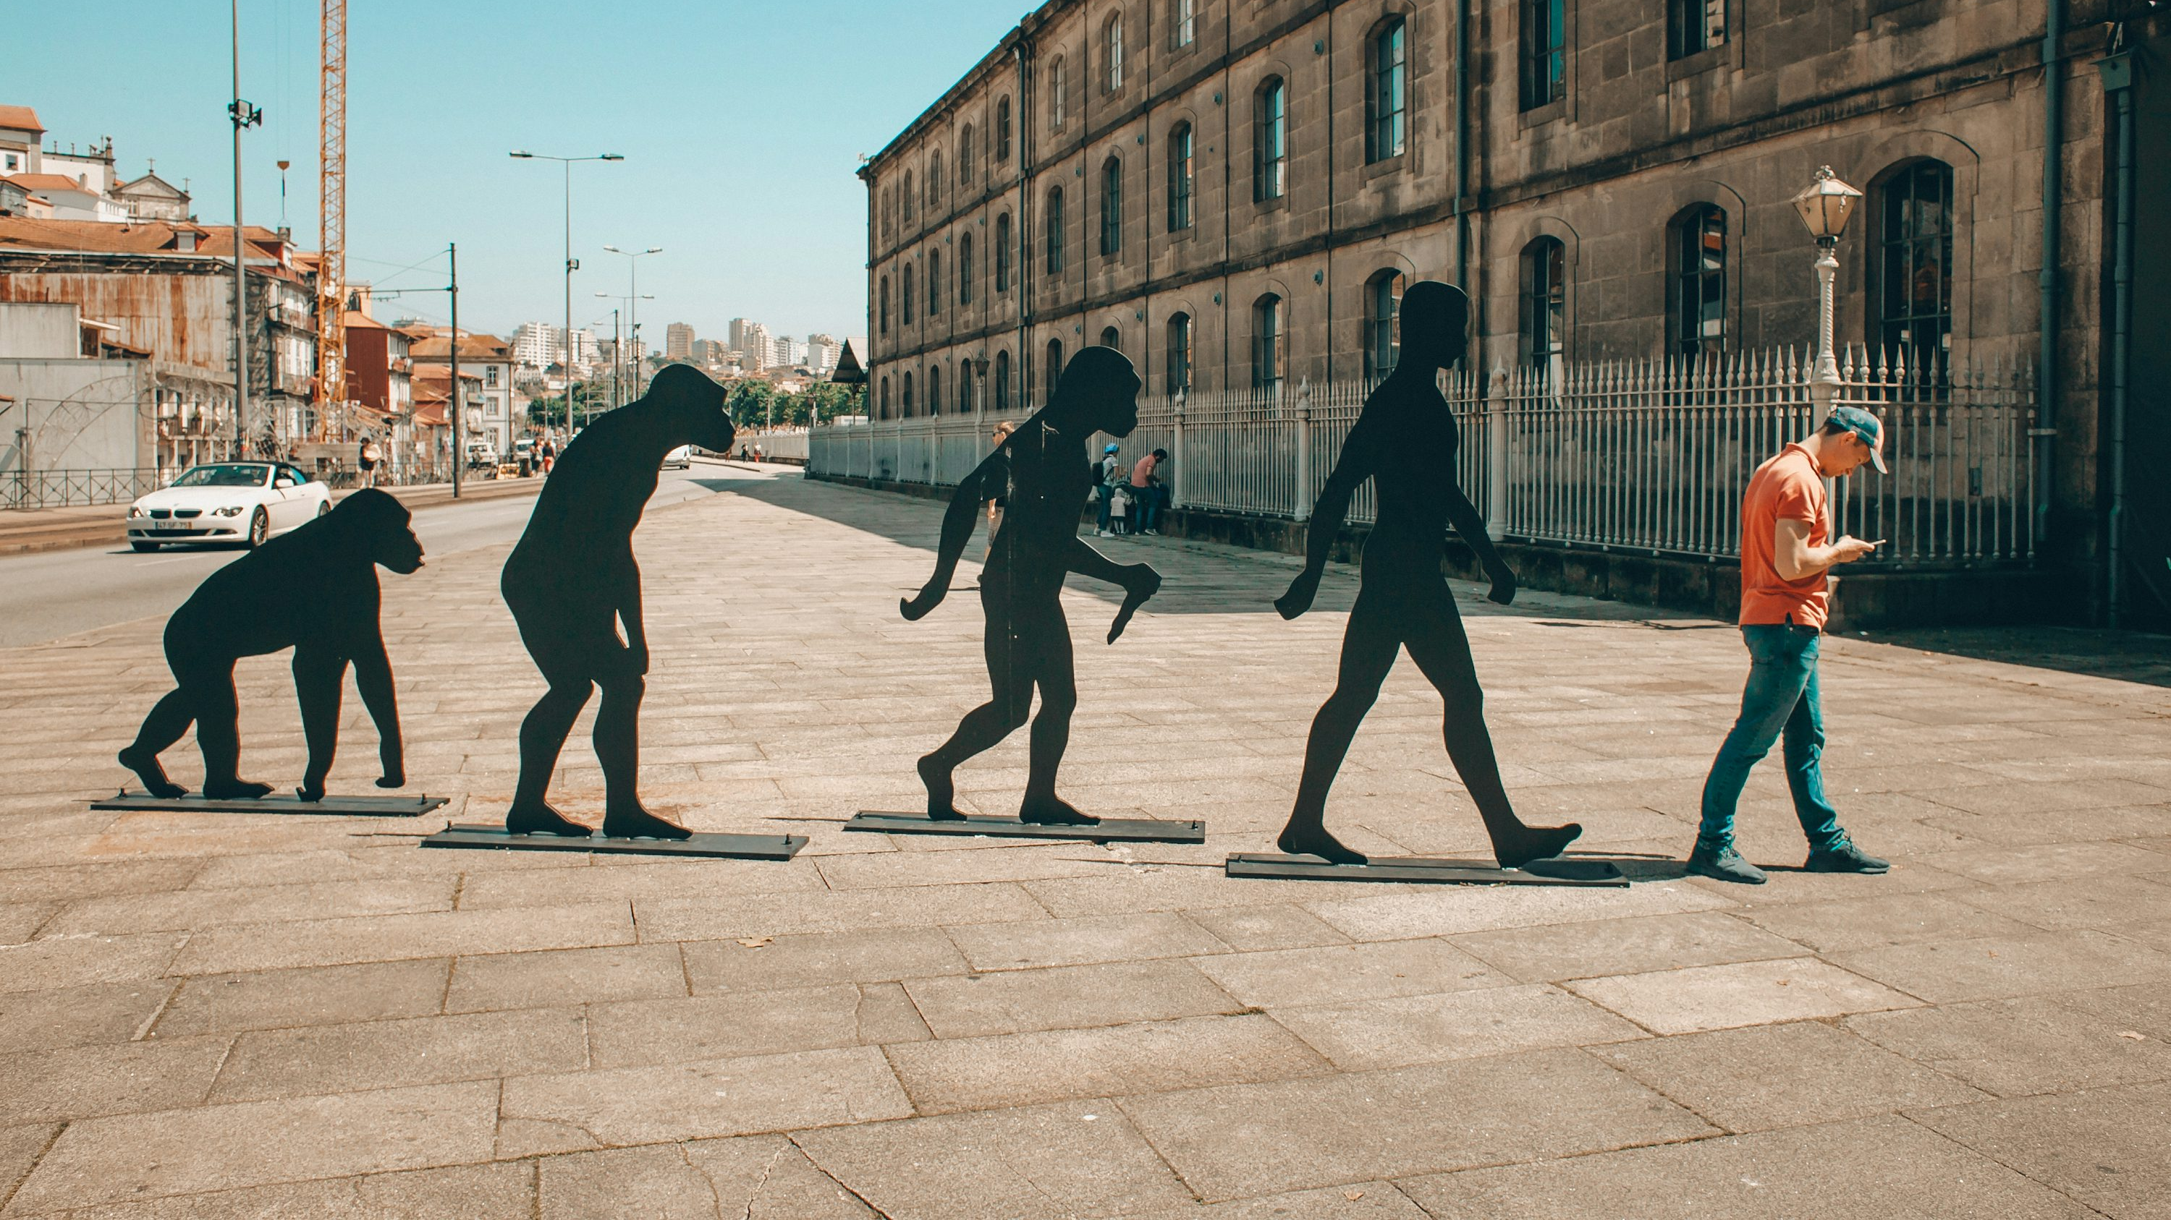
EVOLUTION
ERA
KEY INNOVATION
EXAMPLE
1990s
2000s
2010s
2020s
Collaborative filtering
Commercial adoption
AI Integration (deep learning)
Reinforcement & Real-Time AI
GroupLens (Usenet, 1994)
Amazon (1998), Netflix (2006)
Netflix, Youtube, Spotify
Tiktok, Instagram Reels
The 2010s marked the real AI revolution in recommendation — where algorithms began learning autonomously from millions of behavioral signals.

Slide 4

ANALYSIS
Design
Moral
Ethical
Human-Centered
Wellbeing & Addiction
Governance & Data
Norman’s Principles:
visibility (clear feedback in feed),
mapping (scroll = next video),
feedback (likes/views).
Affordances abused:
infinite scroll becomes addictive.
Gee’s Guidelines:
stimulation yes, but ergonomics & wellbeing ignored.
Evidence: Problematic TikTok Use (validated scales).
Short-form linked to attention reduction.
WHO: sedentary guidelines → higher screen time = obesity/health risks.
EU fines for data/privacy violations.
Algorithm opacity → filter bubbles, misinformation.
Global bans on government devices = trust issue.
Notes:
First, let’s look at this technology through a design lens…”
“Now, if we shift to the moral perspective, the wellbeing issues become clear…”
“Finally, from an ethical standpoint, governance and trust are central…”

Slide 5
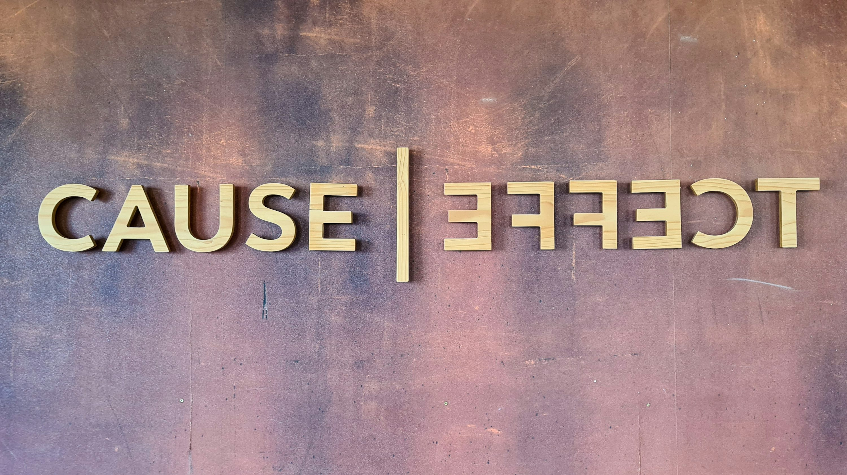
IMMEDIATE EFFECTS
1B+ adoption: content discovery without search.
Changed knowledge flows: “micro-learning” formats.
Industry response: IG Reels, YT Shorts - all adopted the tech.

Slide 6
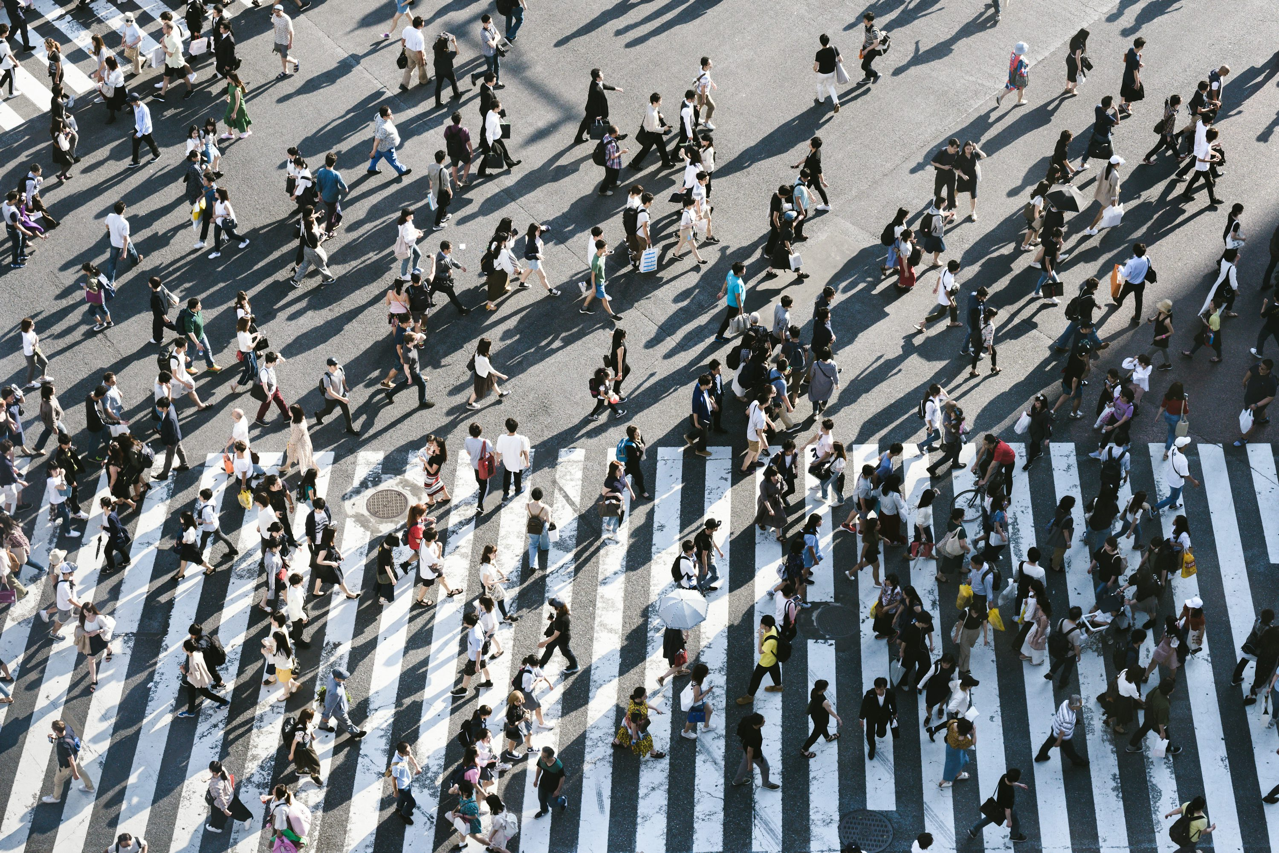
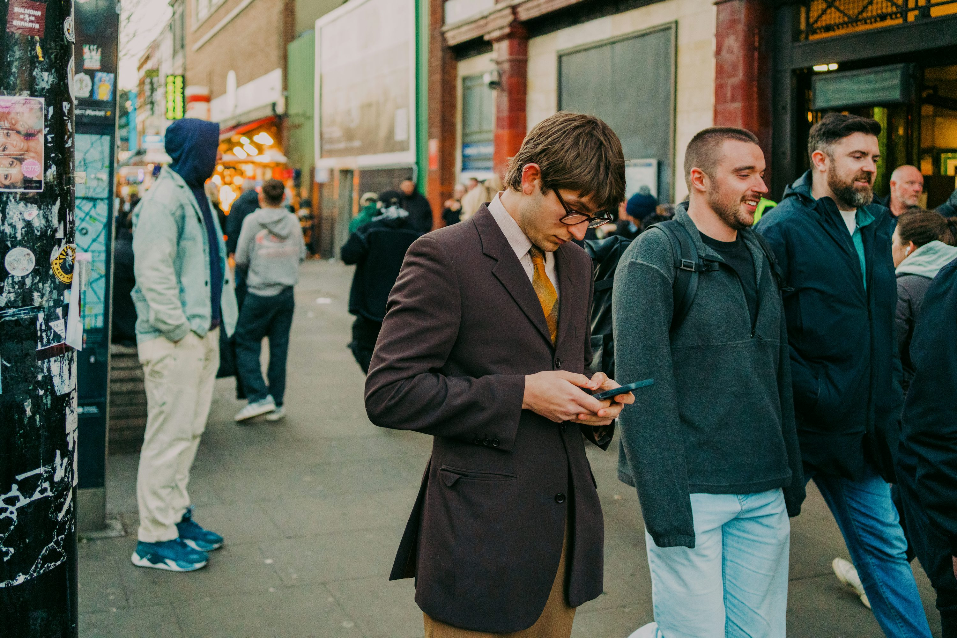
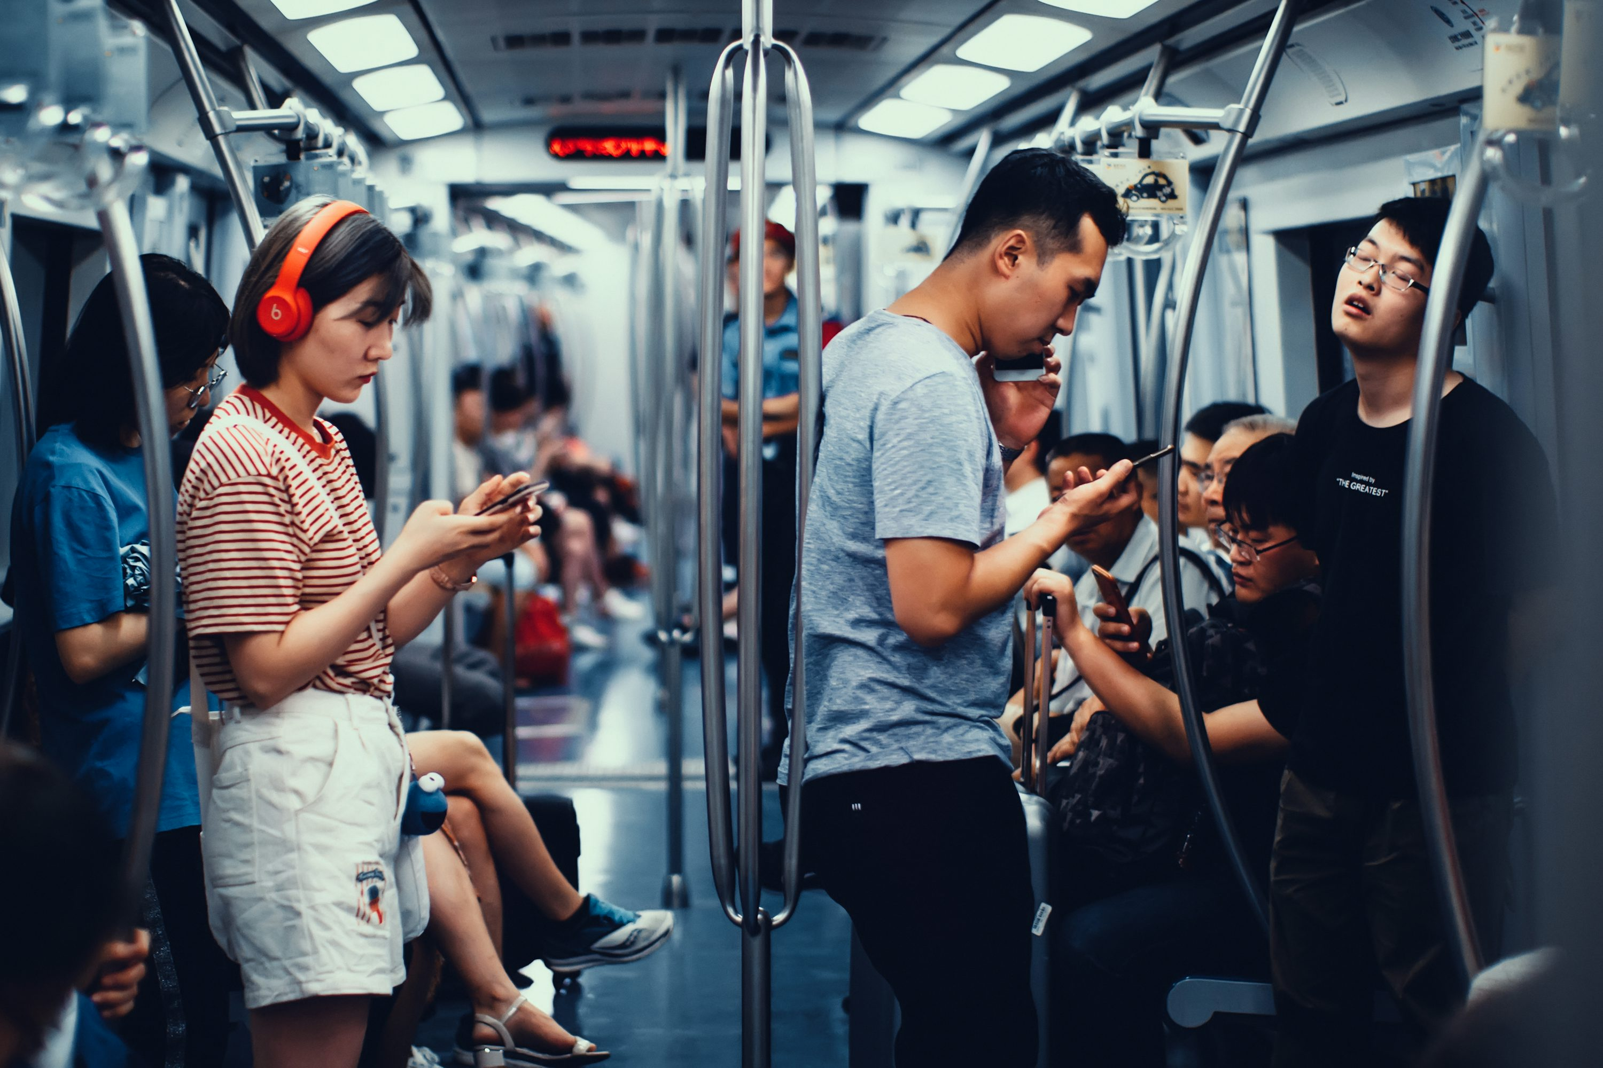
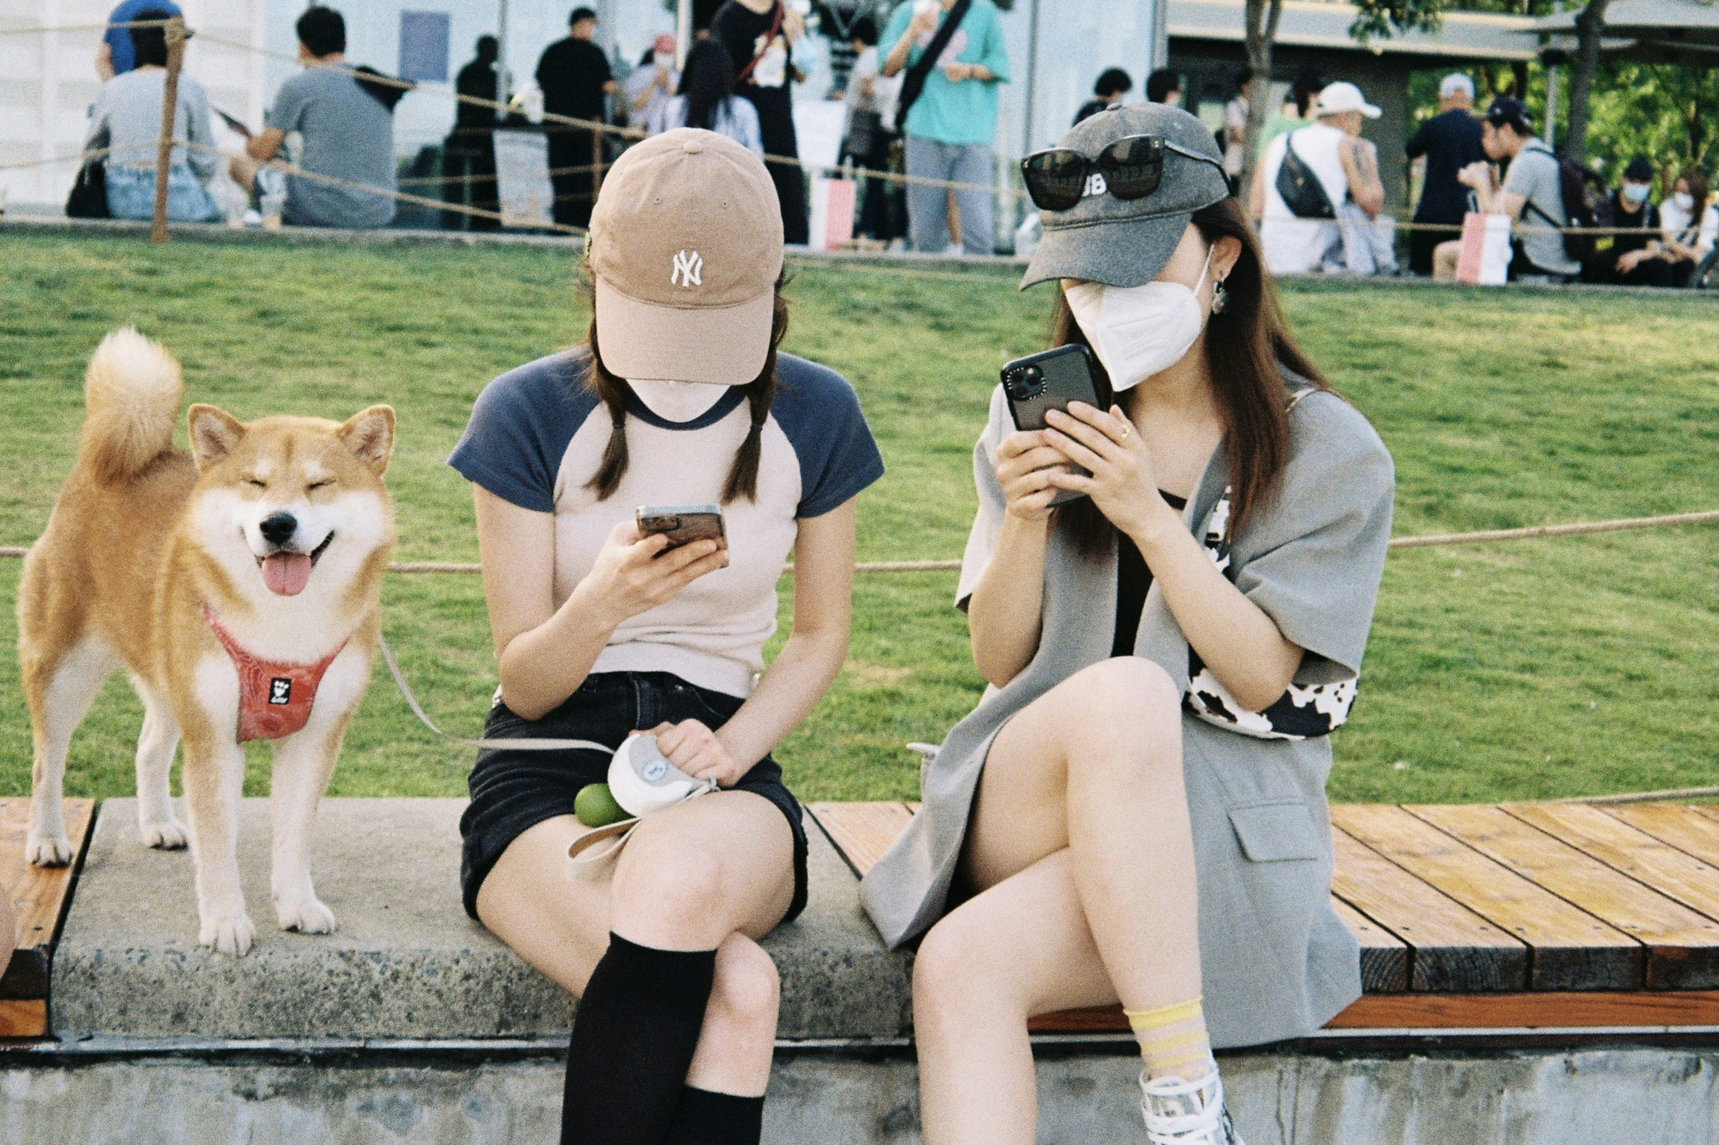
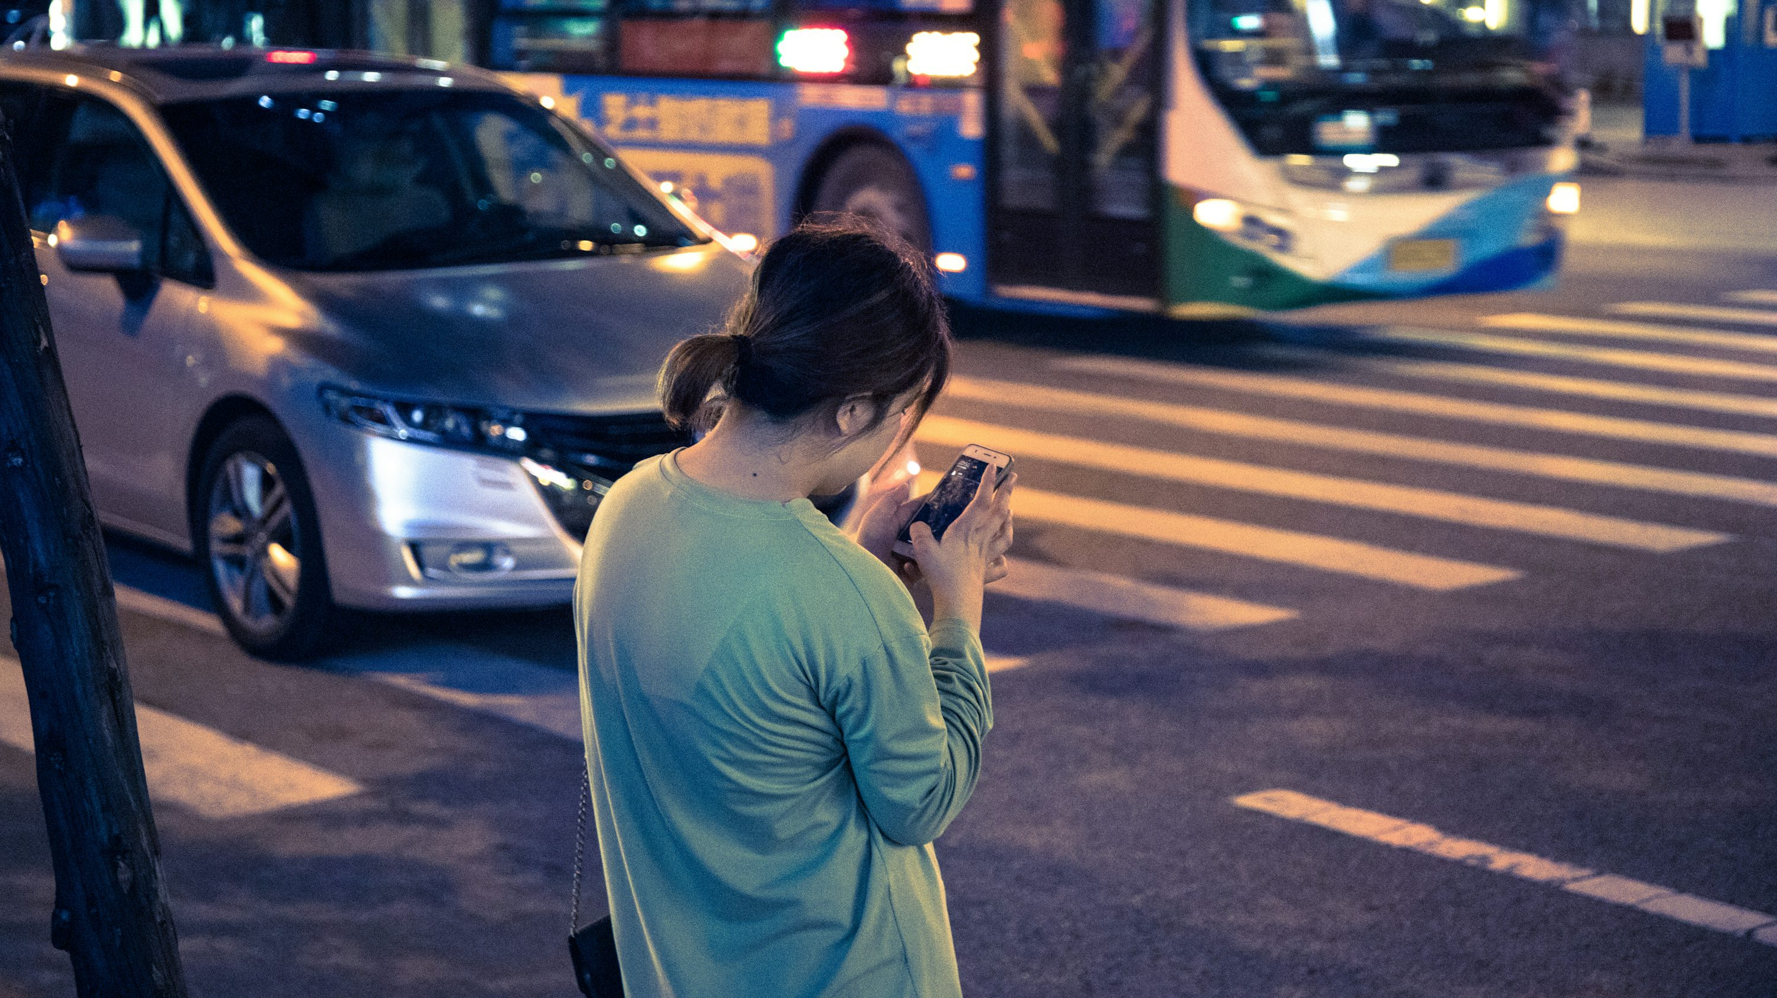
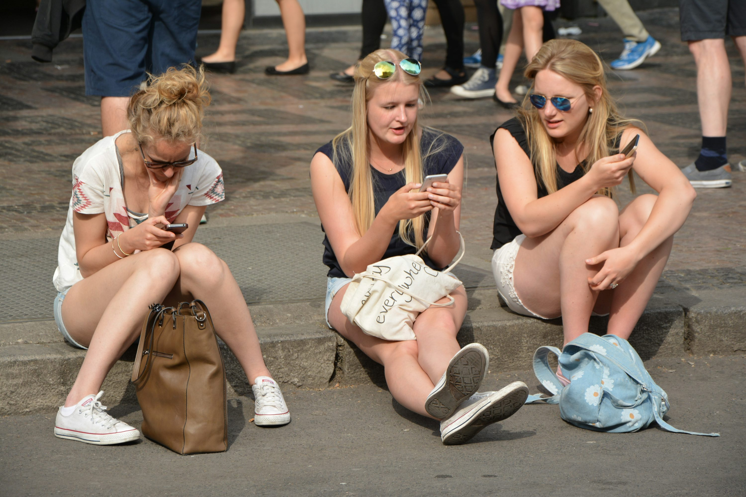
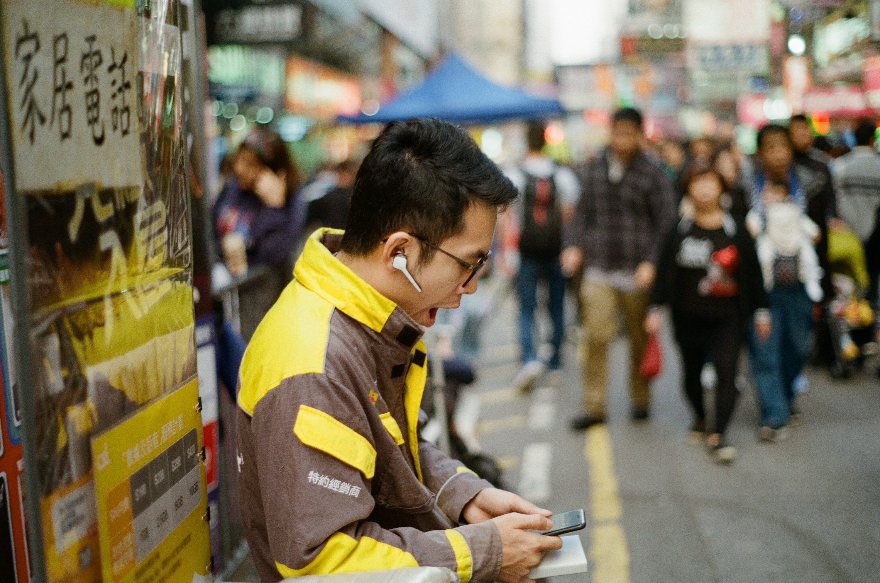
SOCIETAL SHIFTS
New influencer economy
Meme culture dominance
Commerce: live shopping integrations
Negative: reduced face-to-face, sedentary lifestyles.

Slide 7

LONG TERM EFFECTS
🟢 democratized creativity, cultural exchange
🔴 attention fragmentation, rising anxiety, global mistrust in platforms
Paradox of Technology (Norman):
"More power = More complexity and Risks."

Slide 8
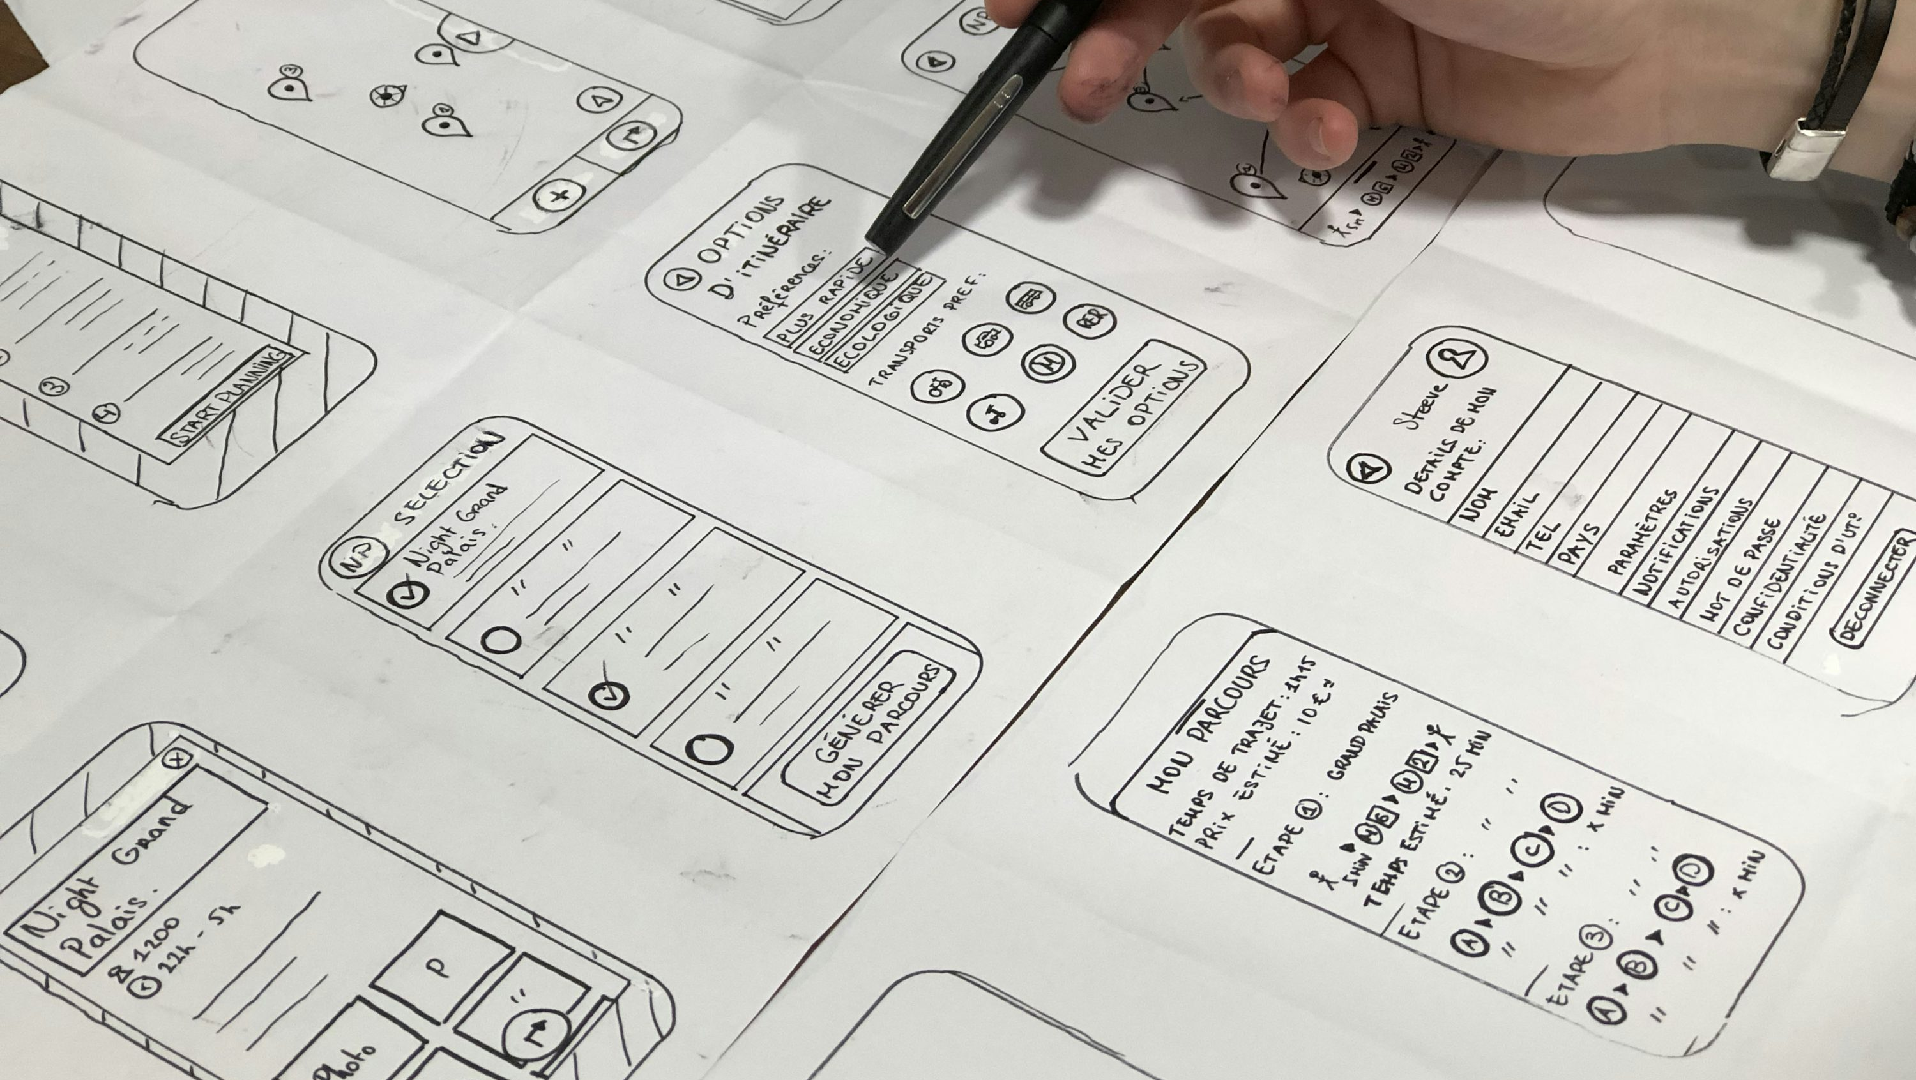
DESIGN RECOMMENDATIONS
Wellbeing by Default
Content Diversity
Data Transparency / Control
integrate time reminders and mindful use features like feed pacing and high-usage threshold.
ensure exposure to varied viewpoints through randomization and diversity controls sliders.
provide clear audits like 3rd party audits, parental tools, and localized storage options.

Slide 9

takeaways
Recommender systems are the technology that drives TikTok’s success and controversy.
They exemplify both human-centered design brilliance + ethical challenges.
The future of HCD depends on designing algorithms for wellbeing, not just engagement.

Slide 10

references
World Health Organization. (2020). WHO guidelines on physical activity and sedentary behaviour. https://www.who.int/…
Bull, F. C., et al. (2020). 2020 WHO guidelines… Int. J. Behav. Nutr. Phys. Act., 17, 141. https://doi.org/10.1186/s12966-020-01037-z
Aykut, G., et al. (2023). Reliability and validity of the problematic TikTok Use Scale… Frontiers in Psychiatry, 14. https://doi.org/10.3389/fpsyt.2023.1068431
Haliti-Sylaj, L., & Sadiku, A. (2024). Impact of short reels on attention span… Eurasian Journal of Applied Linguistics, 10(3), 60–68.
Zhang, X., et al. (2024). Mobile phone short video use negatively impacts attention… Frontiers in Human Neuroscience. https://doi.org/10.3389/fnhum.2024.1383913
Shojaati, M., et al. (2022). Screen time increases overweight and obesity risk among adolescents: Systematic review & meta-analysis. BMC Primary Care, 23, 220. https://doi.org/10.1186/s12875-022-01761-4
Wang, Y., et al. (2022). Effect of screen-time intervention on obesity… Meta-analysis of RCTs. Preventive Medicine. https://doi.org/10.1016/j.ypmed.2022.107021
Bountouridis, D., et al. (2023). Filter bubbles in recommender systems: Systematic review. arXiv:2307.01221.
Nielsen, R. K., et al. (2022). Echo chambers & polarisation: Literature review. Reuters Institute. https://doi.org/10.60625/risj-etxj-7k60
Reuters. (2025, May 2). TikTok fined €530m… (EU DPC).
Jannach, D., Pu, P., Ricci, F., & Zanker, M. (2021). Recommender systems: Past, present, future. Ai Magazine, 42(3), 3-6.
Dong, Z., Wang, Z., Xu, J., Tang, R., & Wen, J. (2022). A brief history of recommender systems. arXiv preprint arXiv:2209.01860.

Slide 11
RESEARCH PRESENTATION: EVOLUTION OF TECHNOLOGY
Thank You
October, 2025
Luis G. B. A. Faria
Student ID A00187785
Human-Centred Design
Prof Dr. Omid Haas

